Slide 1
ONLINE REPUTATION MANAGEMENT (ORM)
Online reputation management is also knowns digital reputation management or internet reputation management
Online reputation management, sometimes abbreviated as ORM, is primarily concerned with managing the results on websites that evaluate products and services and make recommendations and referrals.
Notes:
Delete this slide when you finish preparing the other slides.

Slide 2
ONLINE REPUTATION MANAGEMENT (ORM)
As the Internet and social media became more popular, the meaning has shifted to focus on electronic communities, such as review sites, social media and most prominently the top search results on a brand or individual.
Notes:
Delete this slide when you finish preparing the other slides.

Slide 3
ONLINE REPUTATION MANAGEMENT (ORM)
Here are a few other reasons reputation management is crucial for your business:
1. Almost 80%+ of consumers said they would avoid buying from a brand that comes across as untrustworthy.
2. 59% of shoppers said they perform online research before making a purchase
3. 97% of consumers consult product reviews before buying.
Notes:
Delete this slide when you finish preparing the other slides.

Slide 4
ONLINE REPUTATION MANAGEMENT (ORM)
Sometime people who are not satisfied with your product or services they go to social media, review website and use negative word, bad reviews, testimonials, negative comment, complaints about your businesses. some time our competitors also doing the same things against you.
if such things happened in your business it reduce your business reputation on online.
Notes:
Delete this slide when you finish preparing the other slides.

Slide 5
ONLINE REPUTATION MANAGEMENT (ORM)
In such cases where it is not possible to ask for the negative contents to be taken down, experts agree that reputation management is justifiable in this regard,
and some experts advise that the proper thing to do is to push down the visibility of such negative search engine results through proactively publishing useful, positive information about the organizations or individuals by writing blogs, Press Release, creating articles and so on.
Notes:
Delete this slide when you finish preparing the other slides.

Slide 6
ONLINE REPUTATION MANAGEMENT (ORM)
To manage your online reputation effectively, you need to monitor and act across multiple channels like.. 1. Paid Media : This includes Google ads, social media ads, promotions by influencers. 2. Earned Media : press release, blog post on other websites (Guest Blogging), Forum discussion, Reviews on external sites like https://www.trustpilot.com/, https://www.mouthshut.com, https://www.complaintboard.com etc.. 3. Share Media : Your own social media platform. 4. Owned Media : Your own website or email newsletter.
Notes:
Delete this slide when you finish preparing the other slides.

Slide 7

CASE STUDY
One of the most notable case studies of online reputation management (ORM) in India involves the consumer goods giant Nestle India and its flagship product, Maggi Noodles. In 2015, Nestle India faced a severe crisis when its Maggi noodles were found to contain higher-than-permissible levels of lead and MSG (monosodium glutamate), leading to a nationwide ban and massive public outcry.

Slide 8

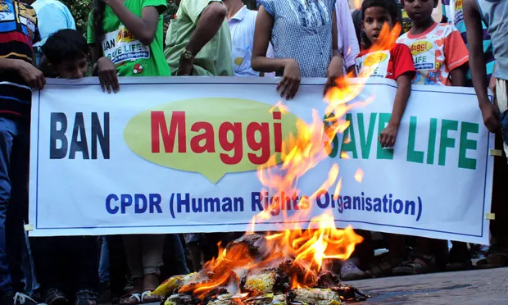
Samples of Maggi noodles were then sent to the Central Food Laboratory in Kolkata in June 2014. The results that came after almost one year in April 2015 read: “MSG: Present and Lead: 17.2ppm (parts per million)". The amount of lead found was over 1,000 times more than what Nestle India Ltd had claimed.

Slide 9

BACKGROUND
Issue Identification:
Public Outcry:
Brand Reputation Damage:
In May 2015, the Food Safety and Standards Authority of India (FSSAI) ordered a nationwide ban on Maggi noodles after tests revealed excess lead content.
The news spread rapidly through social media platforms, leading to widespread panic among consumers and a significant drop in sales.
Nestle India, known for its strong brand reputation, faced severe damage to its credibility and consumer trust.

Slide 10

NESTLE - STRATEGIES FOR ONLINE REPUTATION MANAGEMENT:
Transparency and Communication:
Nestle India immediately responded to the crisis by issuing public statements and engaging with consumers through various online channels.
The company communicated transparently about the steps it was taking to address the issue, including product recall, testing, and collaboration with regulatory authorities.
Social Media Engagement:
Nestle India leveraged social media platforms such as Twitter, Facebook, and YouTube to provide real-time updates, address consumer concerns, and share information about the safety of its products.
The company actively engaged with consumers, responded to their queries and complaints, and provided reassurance about the quality and safety of its products.
Crisis Management:
Nestle India implemented a comprehensive crisis management plan, including appointing a crisis management team, conducting internal investigations, and cooperating with government agencies.
The company took swift action to recall and withdraw Maggi noodles from the market, ensuring consumer safety and compliance with regulatory requirements.

Slide 11
NESTLE - STRATEGIES FOR ONLINE REPUTATION MANAGEMENT:
Media Relations:
Nestle India immediately responded to the crisis by issuing public statements and engaging with consumers through various online channels.
The company communicated transparently about the steps it was taking to address the issue, including product recall, testing, and collaboration with regulatory authorities.
Consumer Outreach & Education:
Nestle India launched a nationwide consumer outreach campaign to educate the public about food safety standards, quality control measures, and the safety of its products.
The company collaborated with nutritionists, food experts, and government agencies to disseminate accurate information and address consumer concerns.

Slide 12

SOCIAL MEDIA STRATEGY BY NESTLE
Real-Time Engagement: Nestle India actively monitored social media platforms such as Twitter, Facebook, and YouTube to track conversations, address consumer queries, and respond promptly to emerging issues related to the Maggi noodles controversy.
Transparency and Information Sharing: The company used social media channels to disseminate accurate information, updates, and announcements regarding the Maggi noodles situation. This included sharing details about product testing, regulatory compliance efforts, and steps taken to ensure consumer safety.
Crisis Communication: Nestlé India utilized social media platforms to communicate its crisis management efforts, reassure consumers about the safety of its products, and address concerns raised by stakeholders. The company employed a proactive approach to crisis communication, providing timely responses to emerging issues and clarifying misconceptions.

Slide 13
SOCIAL MEDIA STRATEGY BY NESTLE
Consumer Engagement and Dialogue: Nestle India engaged directly with consumers on social media, responding to their questions, comments, and complaints in a transparent and empathetic manner. The company encouraged open dialogue, solicited feedback, and addressed consumer grievances to rebuild trust and credibility.
Content Strategy: Nestle India developed a content strategy focused on educating consumers about food safety, quality control measures, and the manufacturing process of Maggi noodles. The company shared informative content, such as videos, infographics, and articles, to reassure consumers and demonstrate its commitment to transparency and accountability.
Collaboration with Influencers and Advocates: Nestle India collaborated with nutritionists, food experts, and influencers to amplify its messages and reach a wider audience. The company leveraged the credibility and trust of influencers and advocates to endorse its products and reinforce key messages about food safety and quality.
Monitoring and Analysis: Nestle India used social media monitoring tools to track sentiment, gauge public perception, and analyze trends related to the Maggi noodles controversy. The company monitored key metrics such as engagement rates, sentiment analysis, and brand mentions to evaluate the effectiveness of its social media strategy and make informed decisions.

Slide 14
MAHESH GANGURDE
Thanks

